Slide 1
Scientific Workflows Systems : In Drug discovery informatics
Presented By:
Tumbi Muhammad Khaled
3rd Semester
Department of Pharmacoinformatics

Slide 2
Introduction to Scientific Workflows
What is a workflow
General definition: series of tasks performed to produce a final outcome
Scientific workflow – “data analysis pipeline”
Automate tedious jobs that scientists traditionally performed by hand for each dataset
Process large volumes of data faster than scientists could do by hand

Slide 3
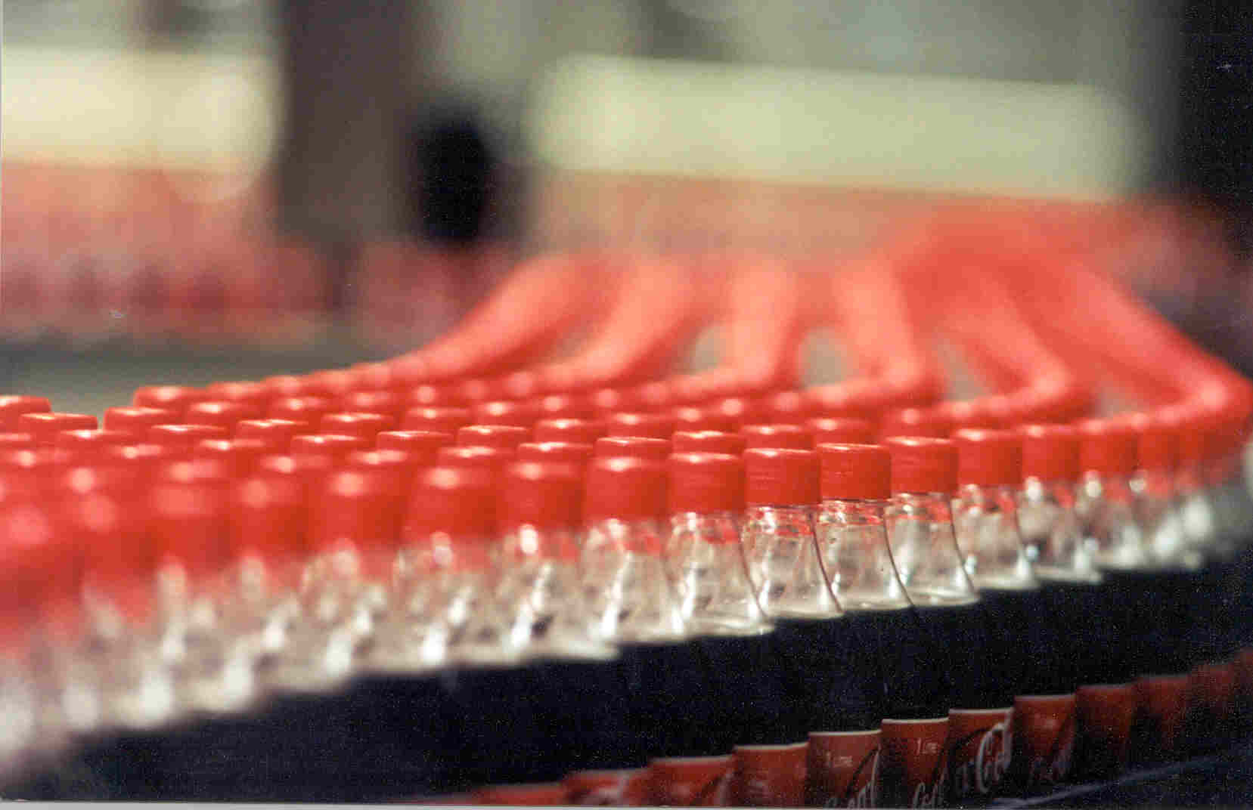
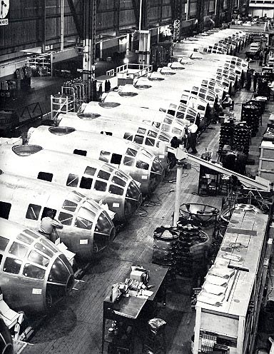
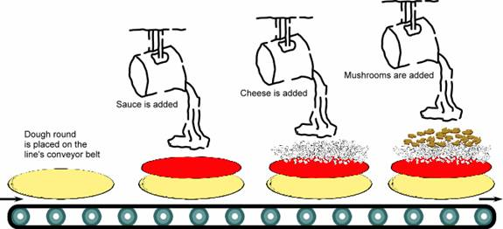
What is a Workflow?

Slide 4
Background: Business Workflows
Example: Planning a trip
Need to perform a series of tasks: book a train tickets, reserve a hotel room, arrange for a rental car for sight seeing, etc..
Each task may depend on outcome of previous task
Days you reserve the hotel depend on days of the flight
If hotel has shuttle service, may not need to rent a car
etc ..

Slide 5
What about scientific workflows?
Perform a set of transformations/ operations on a scientific dataset
Examples
Process Simulation output
Generating images from raw data
Identifying areas of interest in a large dataset
Classifying set of objects
Querying a web service for more information on a set of objects
Many others…

Slide 6
Is this topic is useful to discuss ?????
Yes….

Slide 7
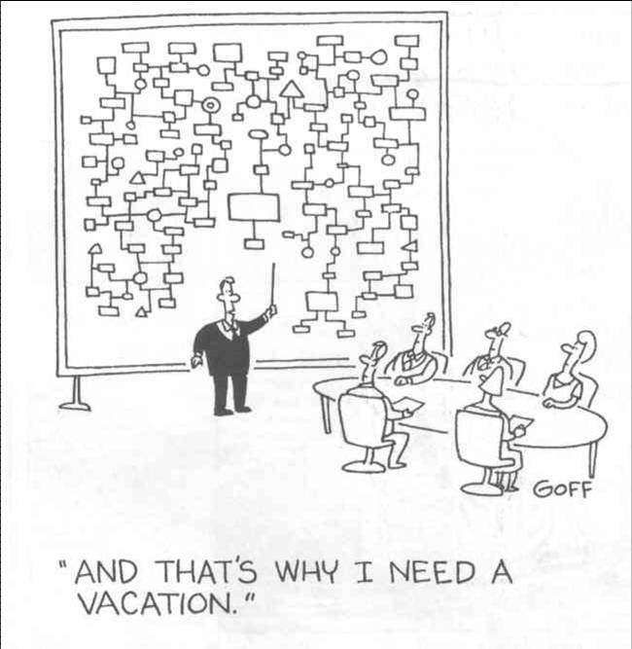
Scientific Workflow Design: Challenges
“And that’s why our scientific workflows are
much easier to develop, understand and maintain!”

Slide 8
Why… Challenges/Requirements
Mastering a programming language
Not all
Visualizing workflow
User interaction
e.g., users may inspect intermediate results
“Smart” re-runs
Changing a parameter after intermediate results without executing workflow from scratch

Slide 9
Why… Challenges/Requirements
Sharing/exchanging workflow
www.myexperiments.org
Formatting issues
File type conversion (OpenBabel)
Locating datasets, services, or functions
Seamless access to resources and services
Web services are simple solution but doesn’t address harder problems, e.g., web service orchestration, third party transfers
Notes:
Orchestration describes the automated arrangement, coordination, and management of complex computer systems, middleware, and services.
It is often discussed as having an inherent intelligence or even implicitly autonomic control, but those are largely aspirations or analogies rather than technical descriptions. In reality, orchestration is largely the effect of automation or systems deploying elements of control theory.

Slide 10
Why…
Industry point Of View:
Schrodinger’s maximum workforce is working on KNIME® base workflow development for its products/ modules which may become rival for market leader Accelrys - Pipeline Pilot ®

Slide 11
Practical Examples ….
There Many Scientific workflows software /Workbenches are available :
Pipeline Pilot ®
Commercially Available from Accelrys®
Market leader in scientific workflow
KNIME
Open source software
Schrodinger’s target to make it as RIVAL for Pipeline Pilot
Include many chemoinformatics NODES were developed to perfome some basic calculation and DATA MINING
TAVERNA WORKBENCH
Open source software
Active development form user
Applications in BIOINFORMATICS

Slide 12
KNIME
KNIME (Konstanz Information Miner) is a user-friendly and comprehensive open-source data integration, processing, analysis, and exploration platform.
KNIME include plugins for CDK (Chemistry Development Kit)
Also have some nodes for Statistical data mining etc..
As already discussed KNIME based workflows for Maestro are also available.
Here we see an VERY SMALL example of workflow for extraction of METADATA from .sdf file

Slide 13
video

Slide 14
TAVERNA WORKBENCH
It is open source workbench developed by University of Manchester
It have many applications only in bioinformatics
No commercial Tie-Ups
Example:-
A simple workflow ( Part of Workflow ) wich will fetch the PDB structure from RCSB database

Slide 15
Video

Slide 16
Advantages of Workflow System
Can perform routine extensive complicated works which may include
Data Transformation
Data mining
Data Analysis
Etc.
without any manual interference which may results in less errors.
Result reproducibility
Reduce data loss
Time saving
etc

Slide 17
Workflow System
As Developer

Slide 18
Thank You
My software never has bugs. It just develops random features

