Slide 1
ChEMBL–Open Access Database For Drug Discovery
By – Udghosh Singh
M.S.(Pharm), 3rd Sem
Pharmacoinformatics

Slide 2
Those who cannot remember the
past are condemned to repeat it

Slide 3
Things you would not like to see in our hits
Specifically: reactive/labile chemical groups
‘structural alerts’
Off-target toxicity
Toxic compounds after metabolic activation
hERG binders, etc

Slide 4
This is not a new concept
If you are a chemist you know many of these
If you have been working in Pharma you know more of these
Pharma companies probably all have their in-house list of ‘forbidden/risky’ structures
Some publications but no definitive public list
Thus reinvention of the wheel, wasted effort

Slide 5
HOW THEY REMOVED UNWANTED STRUCTURS
By using workflow system screening of unwanted structures was carried out
Restrict to organic small molecules
AlogP < 6, Mw < 600, organic compound filter

Slide 6
What is ChEMBL ?
ChEMBL or ChEMBLdb is a manually curated chemical database of bioactive molecules with drug like properties
maintained by the European Bioinformatics Institute (EBI), based on the Wellcome Trust Genome Campus, Hinxton, UK
originally known as StARlite, was developed by a pharmaceutical company, Galapagos NV
new data released monthly

Slide 7
It was acquired for EMBL in 2008 with an award from The Wellcome Trust, resulting in the creation of the ChEMBL chemogenomics group at EBI, led by John Overington

Slide 8
Scope and access
(ChEMBL_02) was launched in January 2010,. This was obtained from curating over 34,000 publications across twelve medicinal chemistry journals
In September 2011 ChEMBL version 11 was launched, with over
Targets: 8,603
Compound records: 1,195,368
Distinct compounds: 1,060,258
Activities: 5,479,146
Publications: 42,516
ChEMBLdb can be accessed via a web interface or downloaded by File Transfer Protocol

Slide 9
Searching ChEMBL
Identifying Compounds interacting with Specific targets
• Text search for protein names/synonyms
• Browse protein or organism tree
• Sequence search using BLAST – also identifies related proteins
Compound Searching
• Search by substructure or similarity
• Search by compound name (e.g. drug name or smiles)
• Search by lists (smiles, names, IDs)
Viewing Results
• view all data
• filter by activity types and potency values
• e.g. compounds with IC50/Ki < 100nM
• Retrieve other data for specific compounds
• e.g. physchem properties, other biological activities

Slide 10
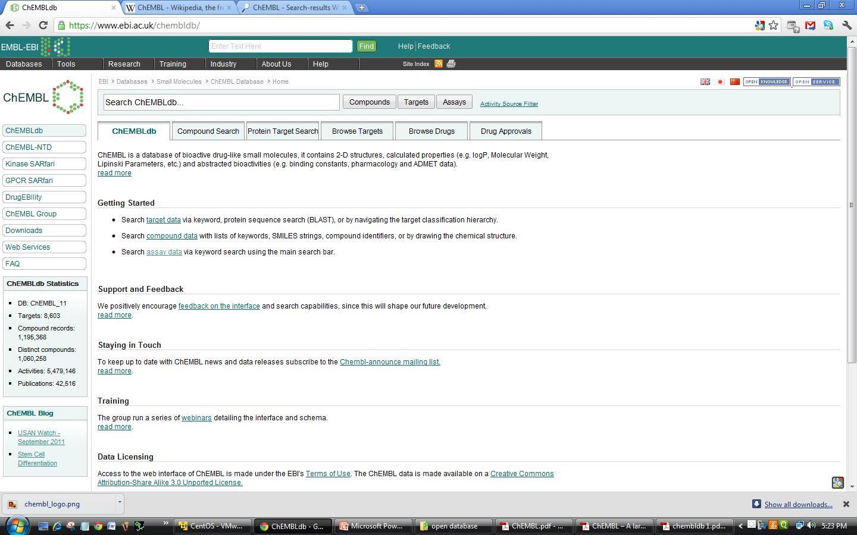
ChEMBL Interface

Slide 11
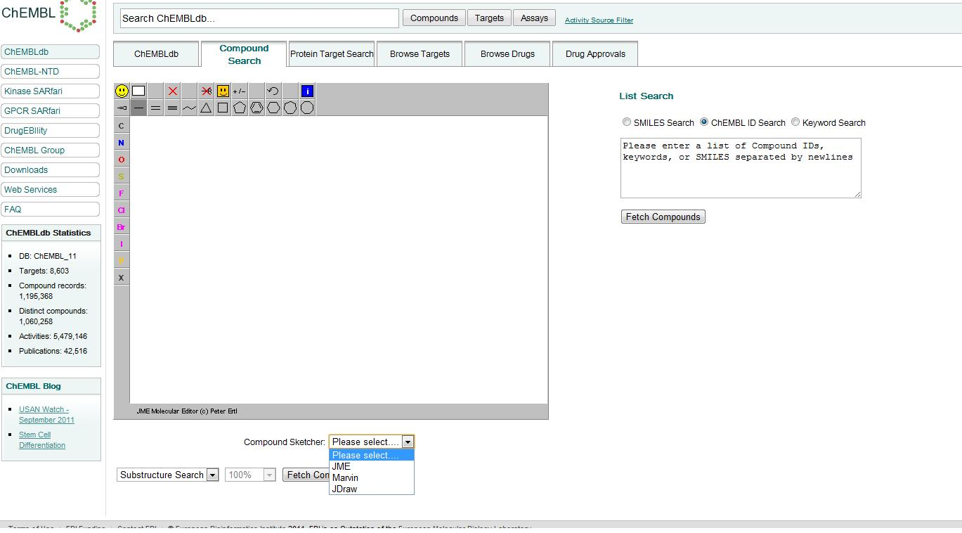
Compound Searching

Slide 12
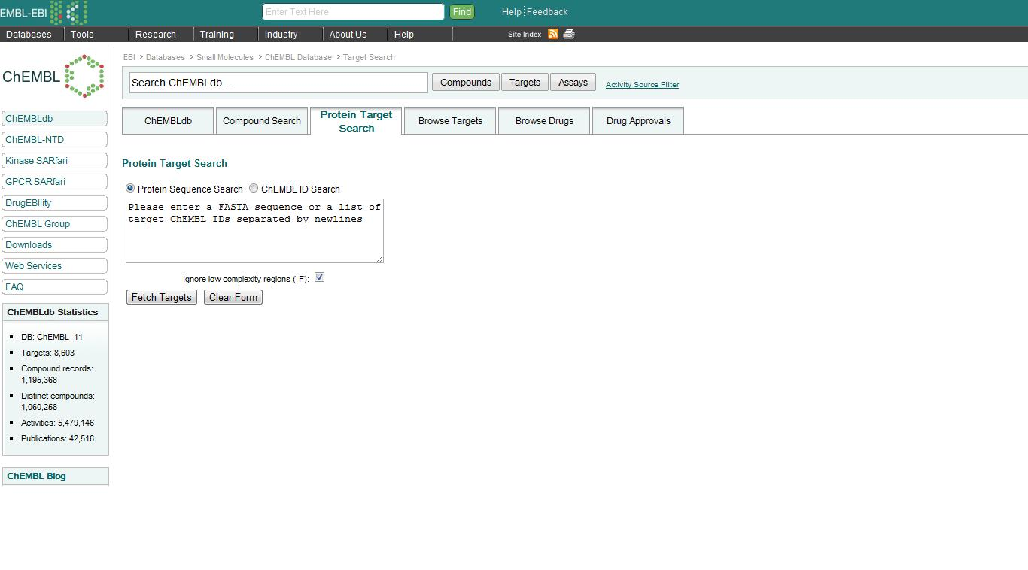
Protein Target Search

Slide 13
BROWSE TARGETS

Slide 14
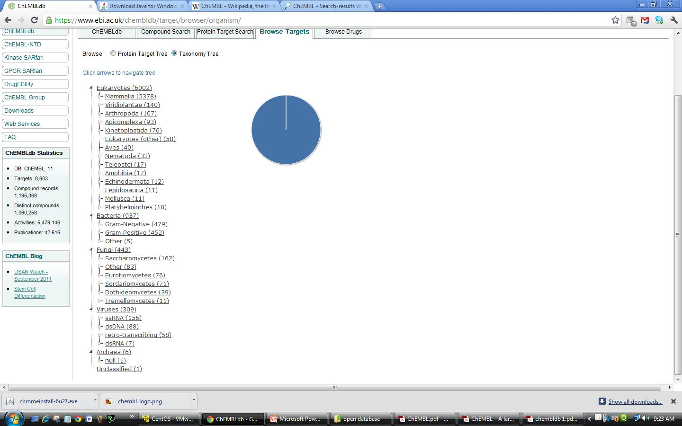
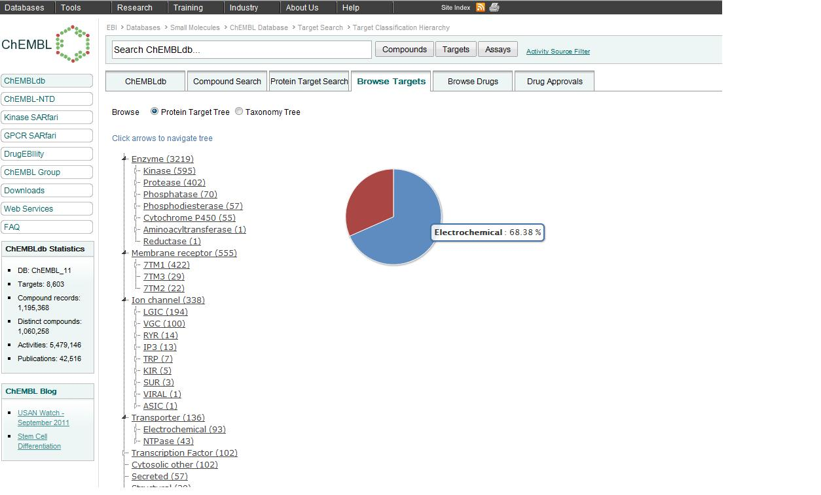

Slide 15
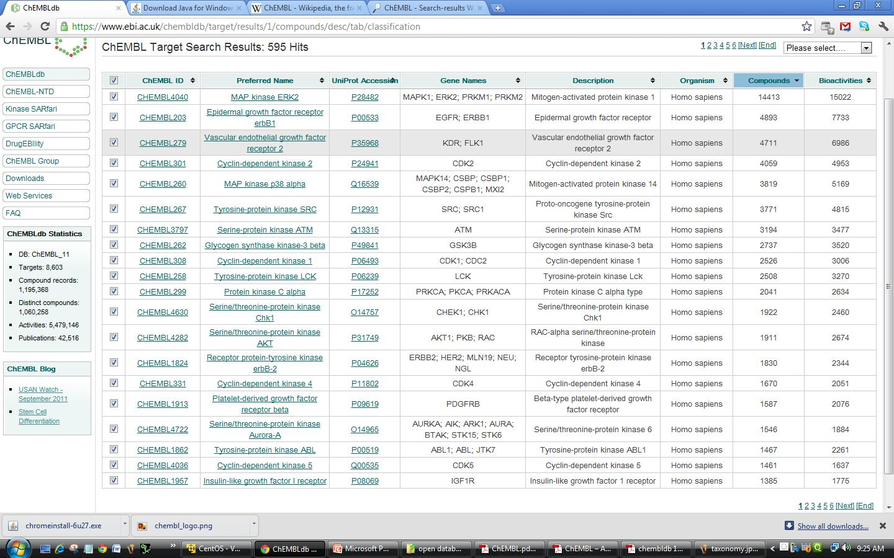

Slide 16
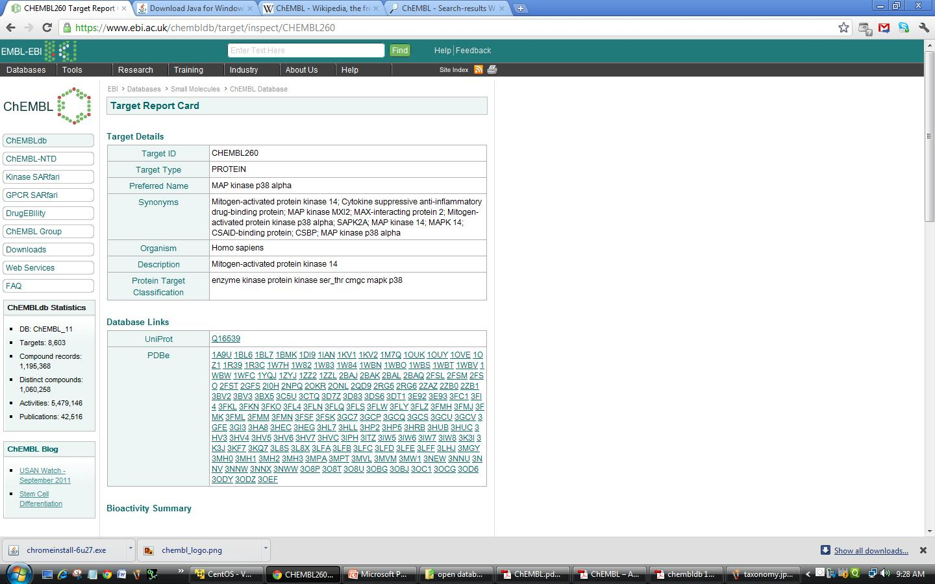
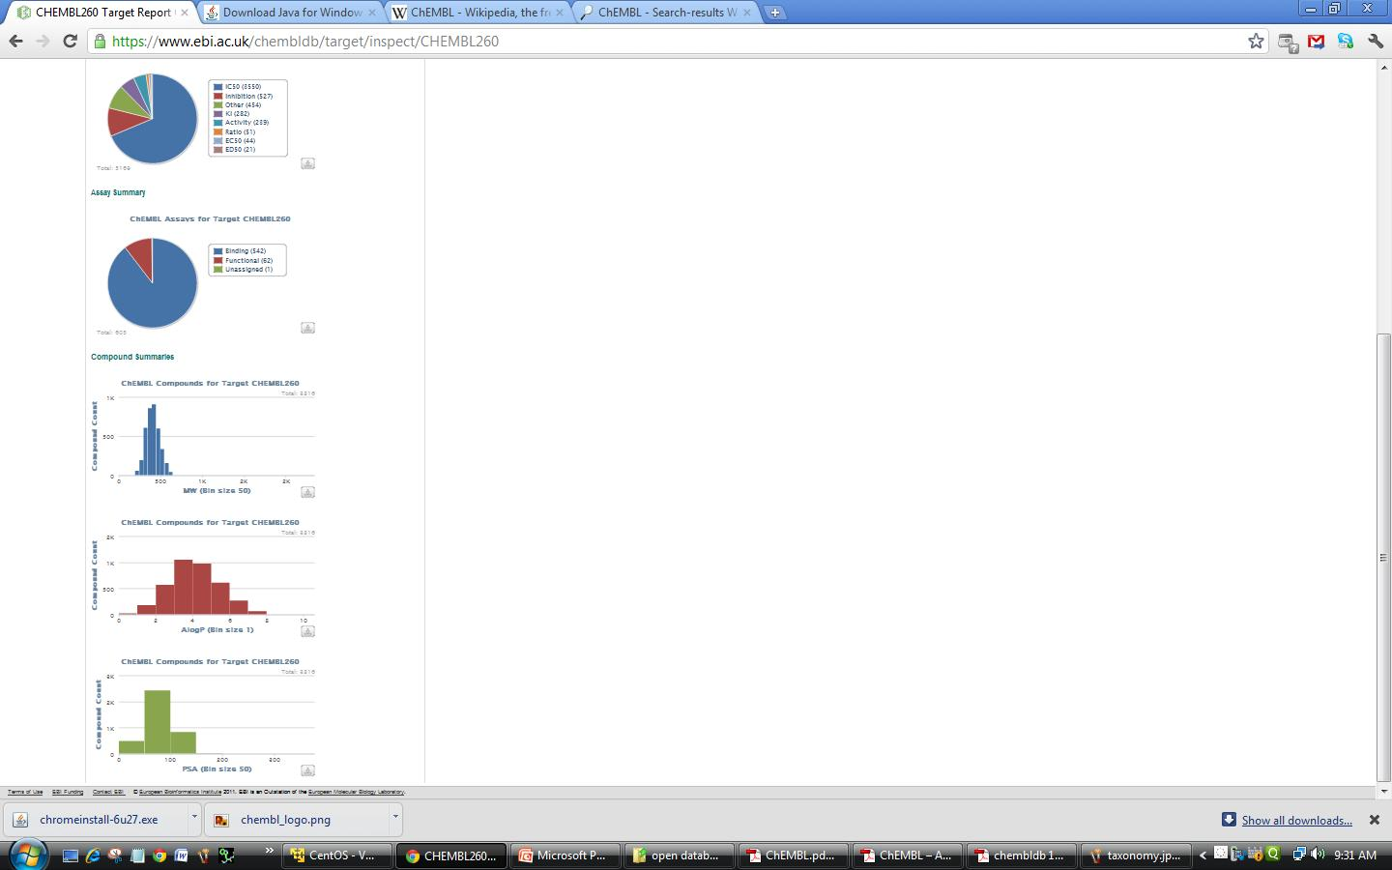

Slide 17
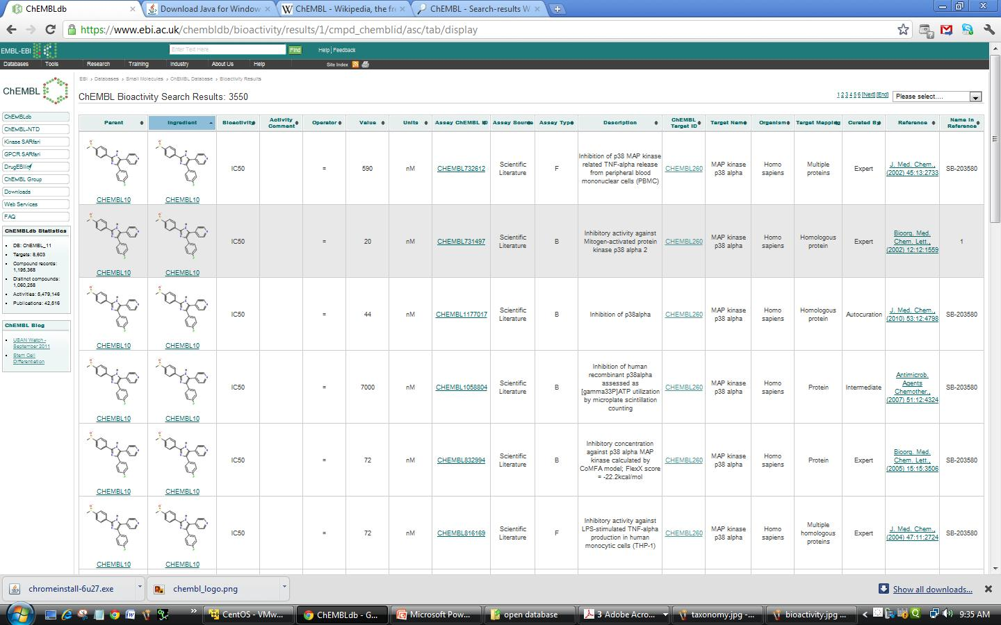

Slide 18
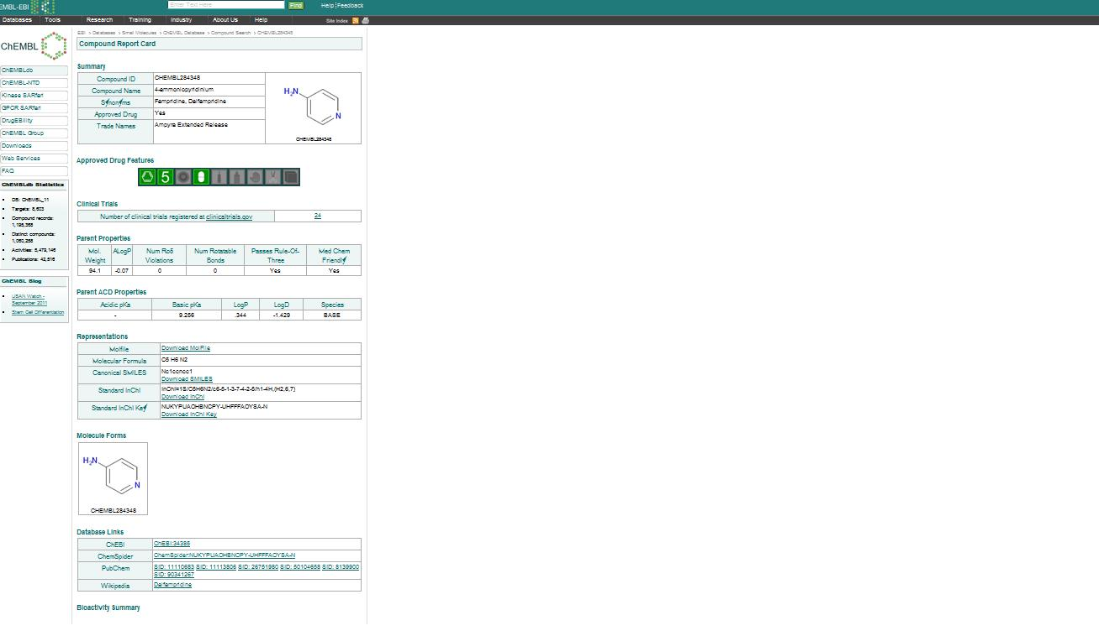
BROWSE DRUGS

Slide 19
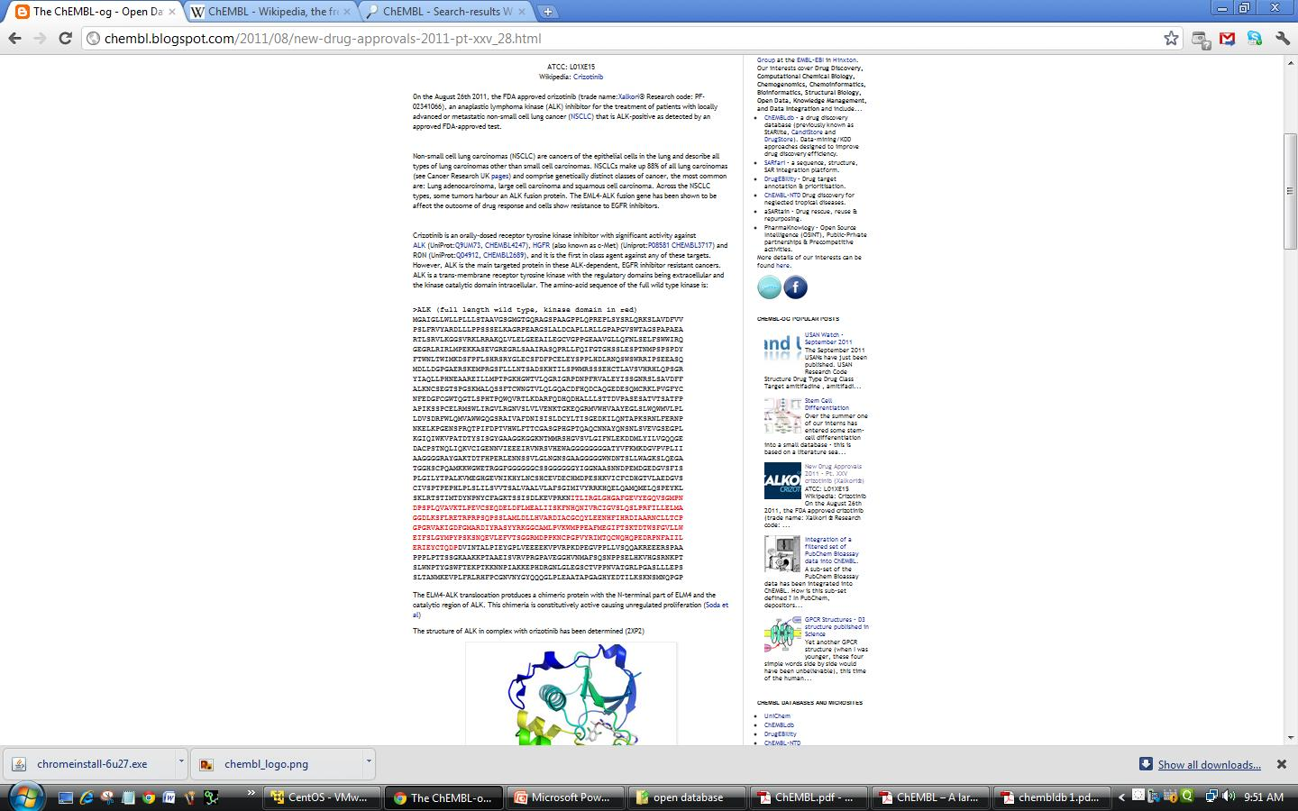
BROWSE APPROVAL DRUGS

Slide 20
OTHER RESOURCES
ChEMBL-NTD - a repository for Open Access primary screening and medicinal chemistry data directed at neglected diseases - endemic tropical diseases of the developing regions of the Africa, Asia, and the Americas
It has three datasets made available to the public for drug discovery purpose –
Deposited Set 1: 20th May 2010 - GSK TCAMS Dataset (hits from P. falciparum whole-cell screening) - inhibitors of proliferation of P. falciparum strain 3D7 in human erythrocytes
dataset contains the structures and screening data for over 13,500 compounds confirmed to inhibit parasite growth by more than 80% at 2 uM concentration
The compounds' activity against the multidrug resistant Dd2 strain has also been measured for comparison
Deposited Set 2: 20th May 2010 - Novartis-GNF Malaria Box Dataset (hits from P. falciparum whole-cell screening)- dataset contains the structures and screening data for over 5,600 compounds, which were tested in dose response and confirmed to inhibit parasite growth by more than 50% at the highest screening concentration (1.25 or 12.5 uM)
Activity against the multidrug resistant W2 strain is also available
Deposited Set 3: 20th May 2010 - St. Jude Children's Research Hospital Dataset-released data detailing effectiveness of nearly 310,000 chemicals against a malaria parasite
identified more than 1,100 new compounds with confirmed activity against the malaria parasite

Slide 21
KINASE SARfari

Slide 22
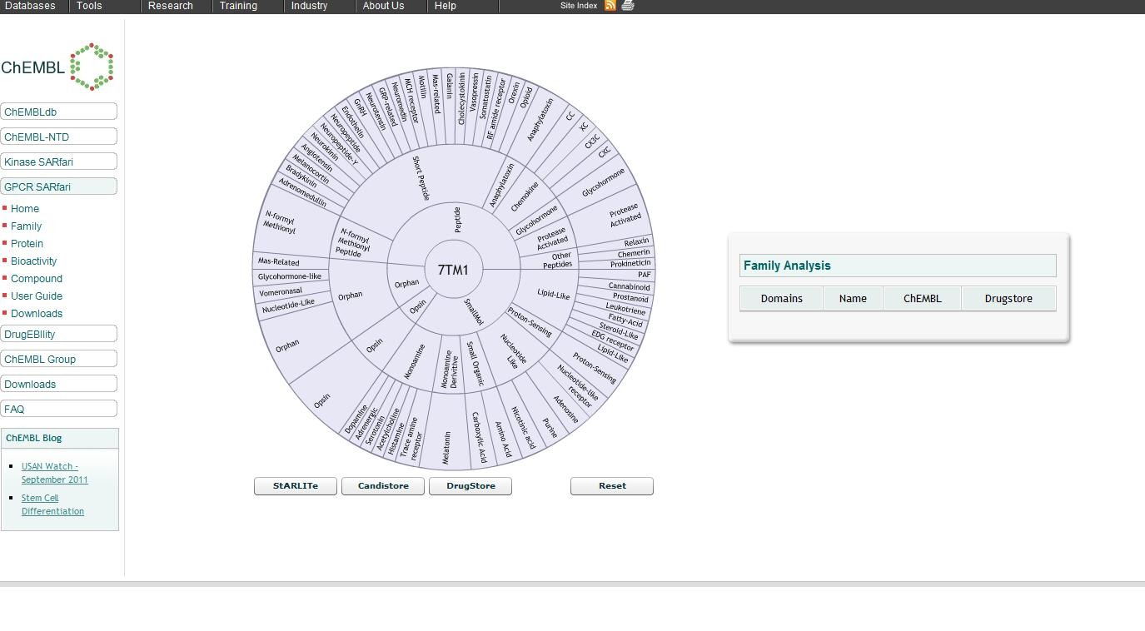
GPCR SARfari

Slide 23
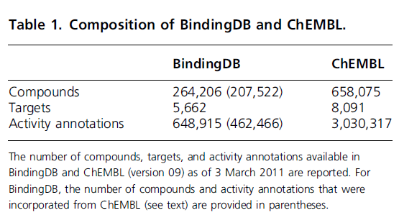
ADVANTAGES OF ChEMBL OVER BINDING DATABASE
ChEMBL is more focused on the annotation of compounds and their targets
Protein targets are organized using a tree hierarchy, which greatly helps to assess target relatedness and organize targets into well-defined classes

Slide 24
BindingDB is more strongly focused on enzyme targets than on membrane receptors because of its initial emphasis on targets with available 3D structures
Hence, GPCR ligands are comparably rare in BindingDB, whereas GPCR ligands and kinase inhibitors are abundant in ChEMBL, probably because of its original drug discovery focus

Slide 25
References
A. Wassermann & J. Bajorath, BindingDB and ChEMBL:online compound databases for drug discovery, Expert Opin. Drug Discov., 6(2011) 683-687
https://www.ebi.ac.uk/chembldb

Slide 26
THANK YOU

